Slide 1

OBSTACLE AVOIDING ROBOT End-Term Project Report For Practical Robotics Projects with Arduino (CSE 4571) Submitted by B. Tech. 7th Semester, CSE Project Supervisor:Siddharth SAHANY
Name | Regd No.
RAJ CHOITHRAMANI | 2241003028
SILOMZI GUMBO | 2241007062
ISHIKA MOURIYA | 2241013366
NISHIKA MOURIYA | 2241013367
SWAYAM MOHAPATRA | 2241013348
SWASTIK MULLICK | 2241013379

Slide 2


Slide 3
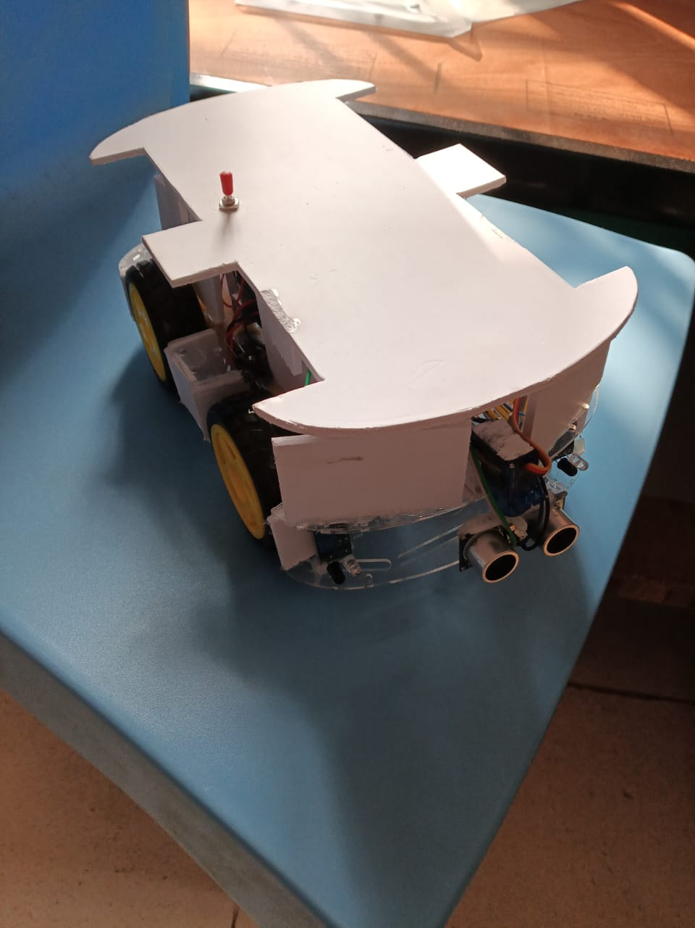
introduction Autonomous robots are designed to navigate environments without human intervention. They rely on sensors to detect obstacles and make real-time movement decisions. This project presents an Autonomous Obstacle Avoiding Robot using Arduino UNO and ESP8266 WiFi. It navigates environments autonomously, detecting obstacles with ultrasonic and IR sensors. Scope of this project: • Sensing Implementation • Control System Development • Autonomous Navigation: To demonstrate the robot's ability to autonomously detect obstacles (e.g., walls, furniture) and take corrective actions to avoid collision without human input. • Wireless monitoring using ESP8266

Slide 4
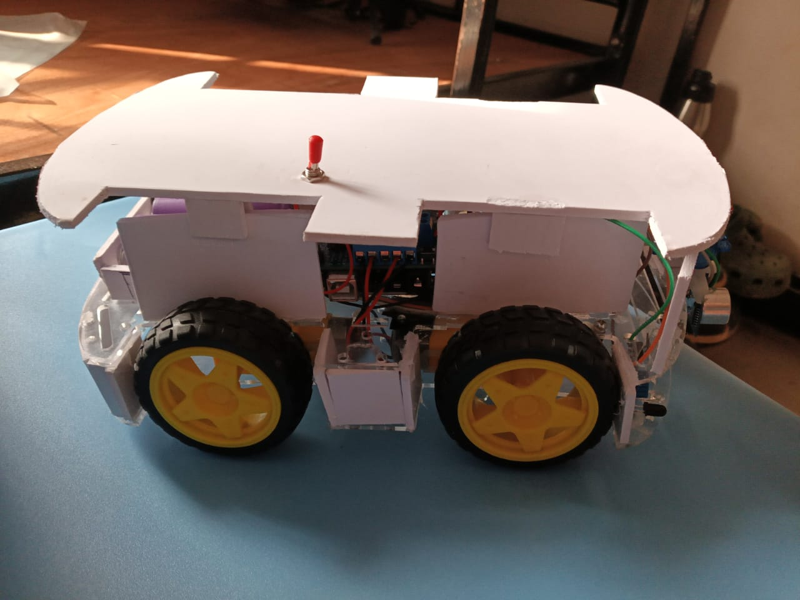

Slide 5
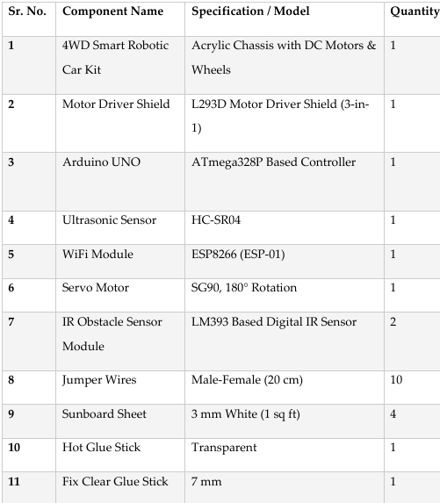
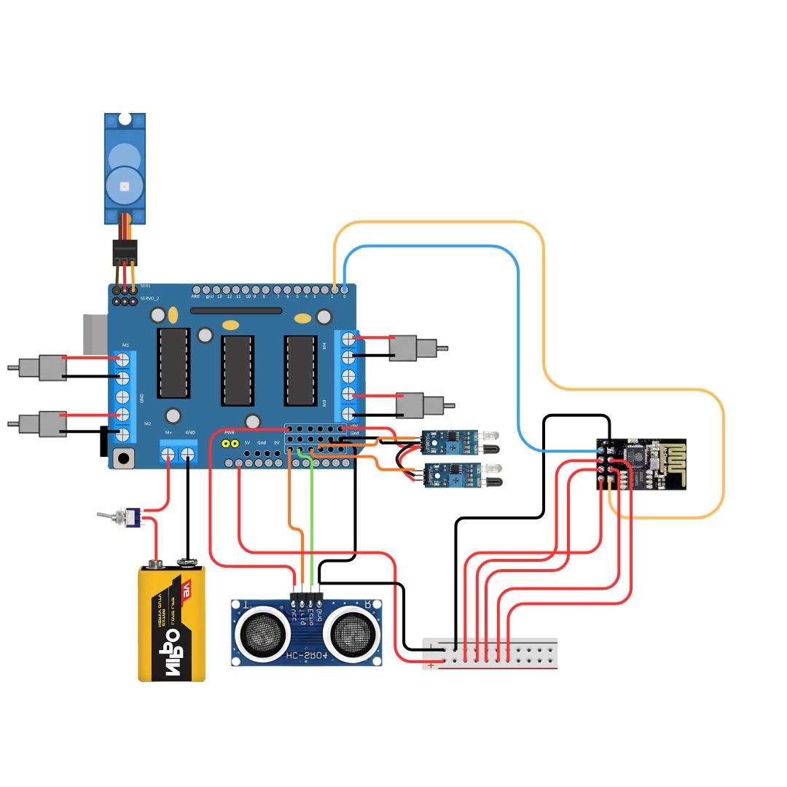
Components and circuit diagram

Slide 6
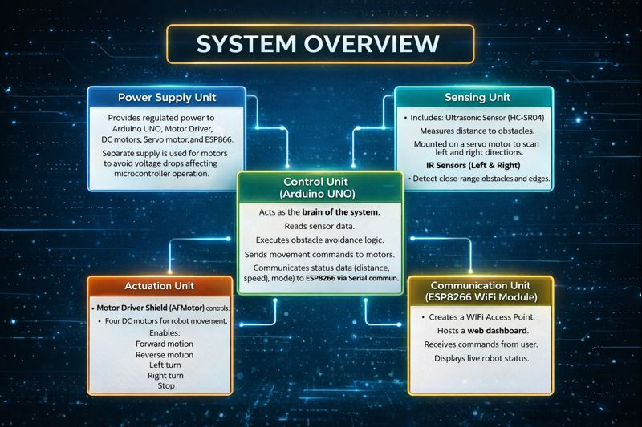

Slide 7
Design Evolution and Development Process
1. Hardware Assembly The robot chassis was assembled with Arduino UNO, motor driver, DC motors, and power supply, and basic movement was tested.
2. Sensor Integration An ultrasonic sensor mounted on a servo motor and front-mounted IR sensors were added to detect obstacles and reduce blind spots.
3. Control Logic Development Sensor data was processed using threshold-based logic to enable smooth obstacle avoidance and decision-making.
4. Wireless Monitoring Integration An ESP8266 WiFi module was integrated to provide real-time monitoring and control through a web-based dashboard.
5. Performance Optimization Motor speed, turning delays, and power stability were fine-tuned to improve navigation smoothness and system reliability.

Slide 9
Working principle of project
Start / Power ON
Sense Environment using Ultrasonic & IR Sensors
Process Sensor Data in Arduino UNO
Decision Making (move Forward/Stop/Reverse/Turn)
Control DC Motors to execute movement
Monitor & Control Remotely via ESP8266 Dashboard

Slide 10
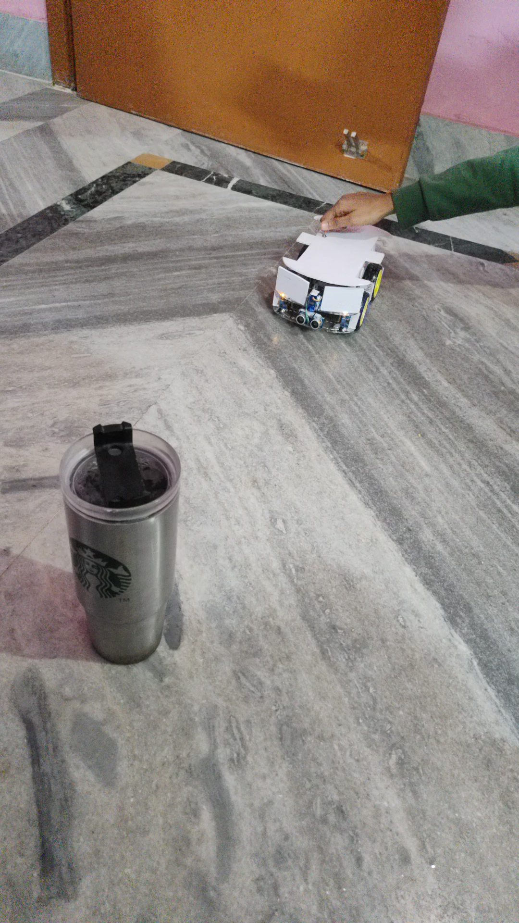
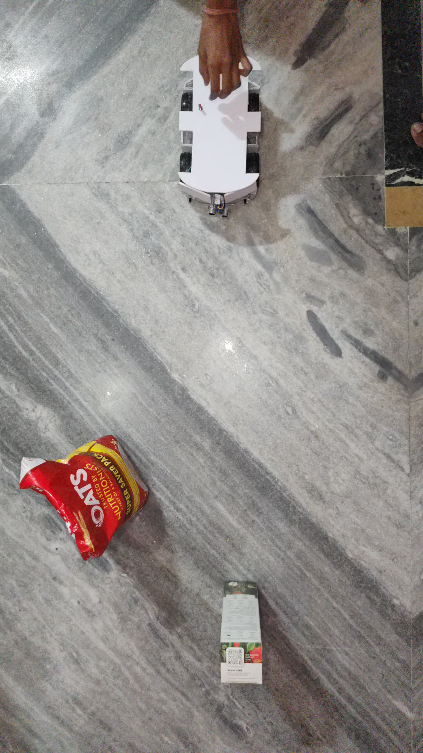
Working demonstration
When there is obstacle in front
When there is obstacle on the right

Slide 11
Robot Movement Logic
Situation / Condition | Sensor Status | Robot Action | Direction of Movement
STOP Mode | Mode = S | All motors stop | Robot stays still
Clear path ahead | Front distance > 20 cm IR Left = HIGH IR Right = HIGH | All motors move forward | Moves straight forward
Obstacle directly in front | Front distance ≤ 20 cm | Stop → move backward → scan left & right → turn | Turns toward clearer side
Obstacle on left side | IR Left = LOW | Scan left & right using ultrasonic | Turns right
Obstacle on right side | IR Right = LOW | Scan left & right using ultrasonic | Turns left
Obstacles on both sides | IR Left = LOW IR Right = LOW | Stop → reverse → scan → turn | Turns toward side with more space
Same distance on left and right | Left distance = Right distance | Default turn logic applied | Turns right
Temporary obstacle detected repeatedly | Fast sensor triggers | Delay + time check applied | Prevents rapid turning
WiFi STOP command given | ESP sends @S | Motors released | Robot stops immediately
Speed changed from dashboard | ESP sends @V command | Motor speed updated | Smooth speed variation

Slide 12
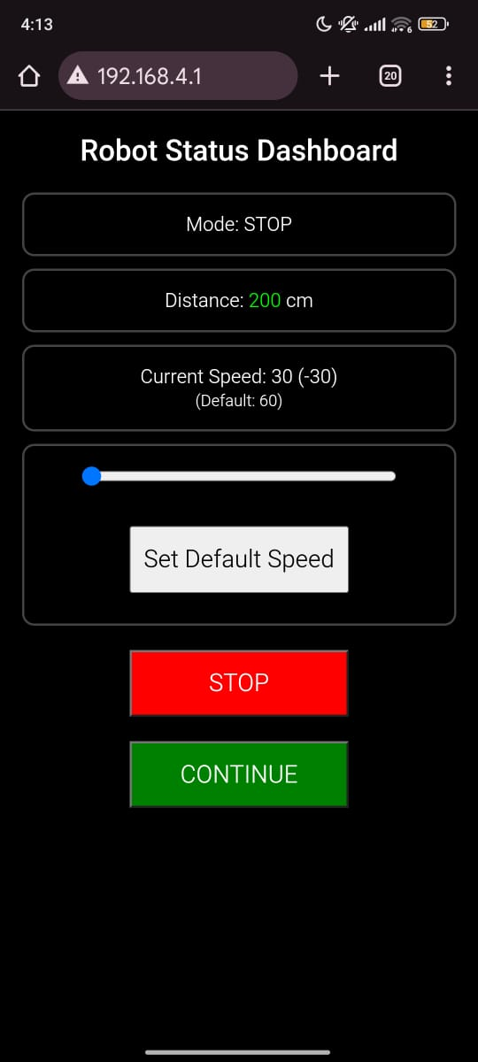
Web-based dashboard
The web-based dashboard is hosted on the ESP8266 Wi-Fi module, allowing users to monitor the robot in real time. It displays operational data such as obstacle distance, speed, and current mode, and provides controls like STOP, CONTINUE, and speed adjustment. This enables remote management of the robot, enhancing safety and usability without needing direct physical interaction.

Slide 13


Slide 14
Challenges and Solutions Implemented
Challenge | Description | Solution / Improvement Implemented
Sensor Blind Spots | Limited detection angle of ultrasonic sensor created blind spots near the robot edges. | Added IR sensors to improve near-range and side obstacle detection.
Detection of Short or Low-Height Obstacles | Ultrasonic sensor mounted on servo could not reliably detect short or ground-level obstacles. | Placed IR sensors at a lower height to detect low-profile obstacles effectively.
Sensor Alignment and Calibration | Minor misalignment caused inaccurate distance readings and incorrect turns. | Carefully aligned and calibrated sensors during hardware setup and testing.
Uneven Surface and Object Reflection | Soft, curved, or irregular surfaces caused incorrect ultrasonic readings. | Combined ultrasonic and IR sensor data to improve detection reliability.

Slide 15

Applications
Applications of Obstacle Avoiding Robot:
Used in industrial automation for material handling in dynamic environments
Applied in warehouse and logistics for autonomous navigation and delivery
Helpful in defense and surveillance to operate in unsafe or restricted areas
Used in healthcare for medicine delivery and assistance robots
Applied in smart homes for cleaning and service robots
Useful in research and education for learning autonomous navigation concepts

Slide 16
Here ARE the links to working of robot:
Working demonstration video link:
click here for working demonstration of obstacle avoiding robot
Web Dashboard explanation video link:
click here for Web Dashboard Explanation
Full Video link:
click here for Full video link

Slide 17
Thank you

